Slide 1
Physical Science Introduction
Mrs. Valentine
Physical Science
4th and 6th Periods

Slide 2
What is Science?
Definition: Science – a way of learning about the natural world through observations and logical reasoning.
It also includes a body of information that can grow and change as new ideas are explored.
Can anyone think of an idea that has been disproven in science?
Notes:
Disproven Ideas Include:
Flat Earth 4 Elements
Geocentric Solar System Spontaneous Generation
Alchemy Pluto is a Planet

Slide 3
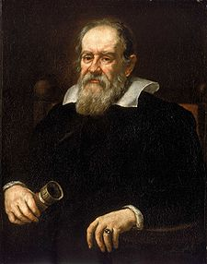
Changes in Science
It all starts with curiosity and scientific inquiry.
Definition: Scientific Inquiry – the various organized methods of investigating problems and answering questions.
For example, Galileo Galilei was studying the stars in a time when it was believed that Earth was the center of the universe.
Curious about the workings of the universe, he studied several planets and the sun.

Slide 4
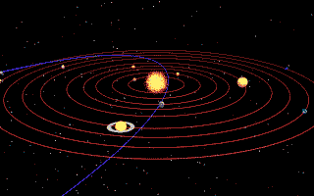
Changes in Science
In 1610, he came to the unpopular conclusion that the universe is heliocentric as opposed to geocentric.
Definition: Heliocentric – centered around the sun
Definition: Geocentric – centered around Earth.
Notes:
Even though his ideas were forcibly recanted at the time, they were much later proven to be true by other scientists.
Galileo is has since been called the “father of modern science.”

Slide 5
This Year’s Goals
Definition: Physical Science – the study of matter, energy, and the changes that matter and energy undergo.
Goal: To learn the skills applied in the scientific method.
Posing Questions
Making Observations & Inferences
Developing Hypotheses
Conducting Experiments
Collecting Data
Notes:
Rather than astronomy, in our class, we will be studying physical science.

Slide 6
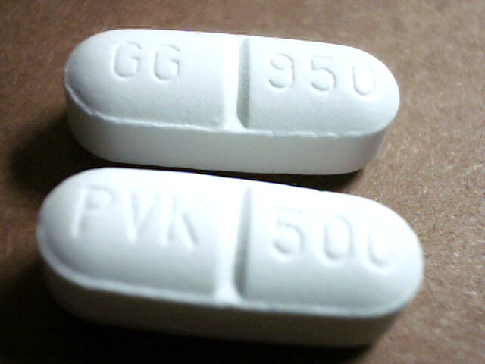
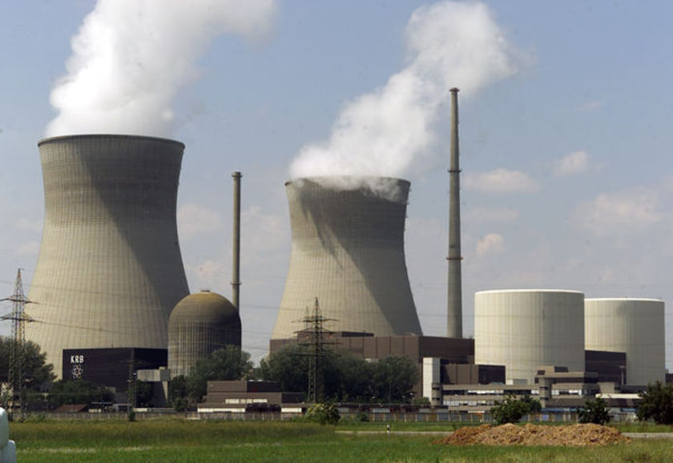
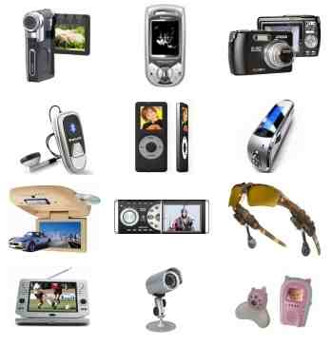
Posing Questions
When it comes to science, it is wise to let your curiosity loose.
It is curiosity that has led to many important scientific discoveries, such as penicillin, nuclear power, and many electronics.
Using your curiosity can help you to solve many problems.
Notes:
Always question everything. Try to find the reasons that things happen.

Slide 7
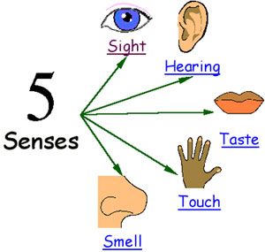
Observing
Once you have determined your question, you must then make observations on your subject matter.
Definition: Observation – using one or more of the five senses to gather information.
Definition: Data – the facts, figures, and other evidence that you learn through observation.
Scientists typically record the data that they collect.

Slide 8
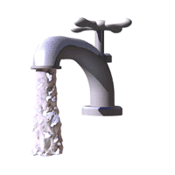
Inferring
Definition: Inferences – a logical interpretation based on observations or prior knowledge.
Example: You observe that hot water turns a toy pink while cold water turns the toy blue.
Inference: Changing the temperature of the water will change the color of the toy.
H
C
Notes:
Observations may be important, but they are not the only important part of the process.
Click bottom right corner to skip the fan demonstration.

Slide 9
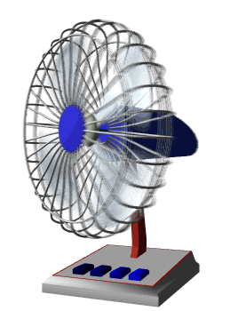
Demonstration
Make three observations using different senses about the fan at the back of the room.
What can you infer from these observations?

Slide 10
Developing Hypotheses
Definition: Hypothesis – a possible explanation for observations.
In science, a hypothesis must be testable by observation or experiment.
Collected information may or may not support the hypothesis.
To continue our toy example, a suggested hypothesis may be: Temperature changes the color of the toy. The water is simply the medium and has no affect of its own.

Slide 11
Hypotheses
Hypotheses are typically accompanied by an educated guess.
For example, you may say that the warmer the temperatures, the more pink the toy will get.
Be careful with your predictions. You do not want to let the experiment be changed to ensure your prediction is correct.
Be absolutely positive that the experiment is still set up independent of your prediction.

Slide 12
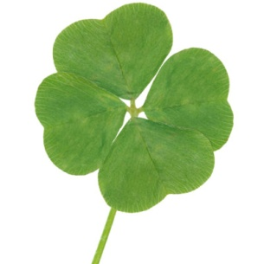
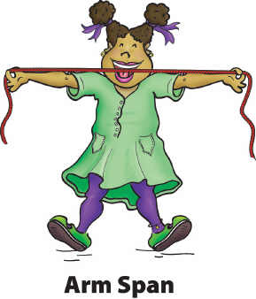
Sample Hypotheses
Determine if each of the following hypotheses are testable or not:
The height of a person affects the size of his or her shadow.
A person’s luck affects the size of his or her arm span.
Temperature changes the color of the toy. The water is simply the medium and has no affect of its own.
Notes:
How would you set up an experiment to test each hypothesis?
End Part 1

Slide 13
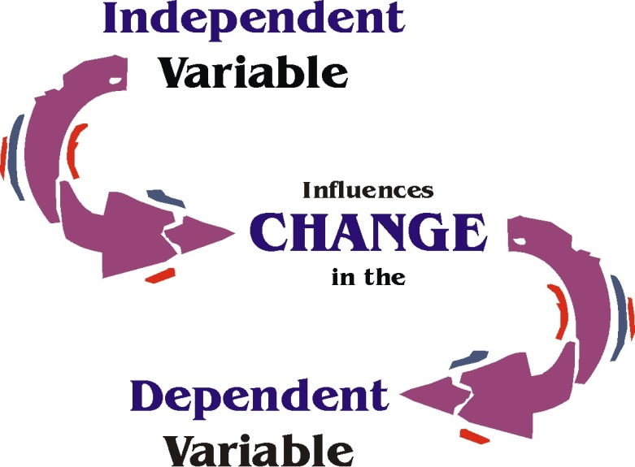
Designing Controlled Experiments
Definitions: Variables – factors that can change during an experiment.
Experiments test hypotheses by using two kinds of variables.
Definition: Manipulated Variable (Independent Variable) – the variable that the scientist changes.
Definition: Responding Variable (Dependent Variable) – the variable that is expected to change as a result of the manipulated variable.

Slide 14
Designing Controlled Experiments
What do you think the manipulated variable of our toy experiment would be? The responding variable?
Manipulated: temperature
Responding: color of the toy
Scientists change only one variable at a time to ensure that it is that variable that is causing the changes they are seeing.
All other variables are kept constant (controlled).
Notes:
Click bottom right corner to skip inquiry challenge with water in beaker.

Slide 15
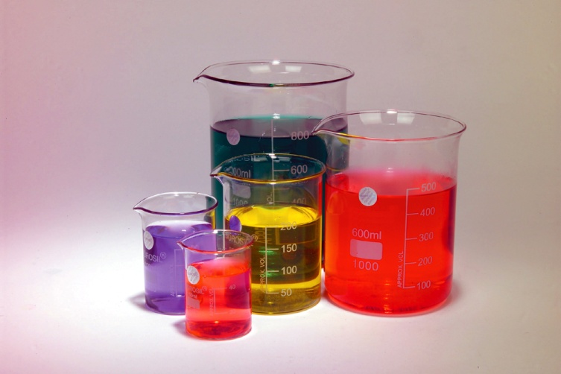
Inquiry Challenge
What does it mean to manipulate something?
To handle, manage, or use, especially with skill, in some process of treatment or performance
Beaker Demonstration.
How did I change the condition of the beaker?
What happened to the sound after I changed the beaker?

Slide 16
Designing Controlled Experiments
Some of the variables that may be controlled in our experiment include the distance from the toy to the heat source, and the length of time that the toy is exposed to the source.
Definition: Controlled Experiment – an investigation in which all variables except one remain the same.
Many of the experiments that we will be doing this year will be controlled experiments.

Slide 17
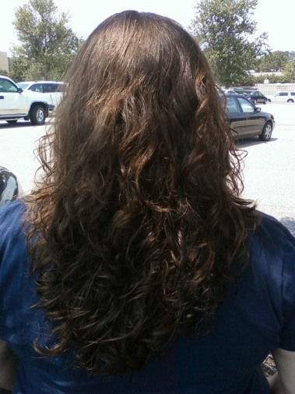
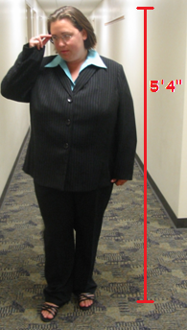
Collecting Data
Scientific data can be either qualitative or quantitative.
Qualitative data is data that does not involve numbers. This typically includes descriptions.
For example, “Mrs. Valentine’s hair is brown” is qualitative data.
Quantitative data is data that does involve numbers.
For example, “Mrs. Valentine is 5 feet and 4 inches tall” is quantitative data.

Slide 18
Collecting Data
When identifying whether data is qualitative or quantitative, you must be careful.
If the number is only used to identify the object being observed, then the data may still be qualitative.
Practice:
I-95 has a traffic jam.
The cookie has twelve chocolate chips.
The fourth button from the left starts the machine.
Humpback whales can swim up to 14km/h.
I-95
has a traffic jam.
Qualitative Data
The cookie
has twelve chocolate chips.
Quantitative Data
The fourth button from the left
starts the machine.
Qualitative Data
Humpback whales
can swim up to 14km/h.
Quantitative Data
Notes:
NOTE: Typically, the data starts with the verb.

Slide 19
Collecting Data
Quantitative data is usually accompanied by a standard unit.
Scientists have come up with a standard system of units called SI Units.
SI stands for the French “Système International d‘Unités,” meaning “International System of Units.”
This system is based upon the metric system.
Notes:
**Greater detail on SI Units to come.**

Slide 20
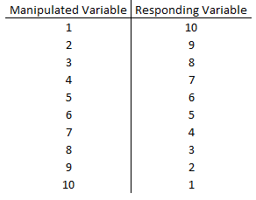
Graphing and Interpreting Data
Scientists interpret data by identifying trends or patterns.
This is frequently done through tables or graphs.
When putting data into a table, the manipulated variable should be in the first column, and the responding variable should be listed in the second column.

Slide 21
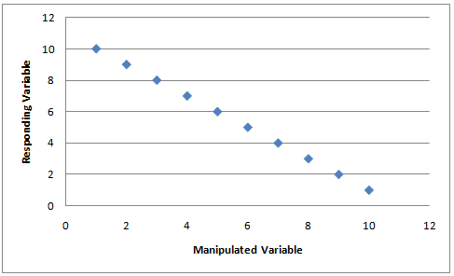
Graphing and Interpreting data.
In the graph, the manipulated variable is on the x-axis (horizontal) and the responding variable is on the y-axis (vertical).
We graph the points by finding the data for both variables and plotting where they intersect.
Let’s have a look at Figure 6 on page 7.

Slide 22
Data vs. Results
Results and conclusions are calculated and determined from data.
How to distinguish between data and results:
Data – measured or observed using the five senses.
Results – calculated and inferred using the data.

Slide 23
Data vs. Results
Example:
Rachael runs at 5m/s is data. It can be measured.
Rachael has a kinetic energy of 1875kJ is a result. This had to be calculated.
E_{K} = 0.5mv²
E_{K} = 0.5(75kg)(5m/s)²
E_{K} = 1875kJ
Not all data/results involve numbers.
Notes:
Use the fan example for qualitative data/results.
The fan blades move – data
When the fan is aimed at a person, that person can feel air passing – data
The fan blades moving cause the air to move, as well – results

Slide 24
Drawing Conclusions
A conclusion states whether the data supported the hypothesis or showed it to be wrong.
Scientists can learn from hypotheses that they prove wrong.
For example, a doctor may have thought that a disease was caused by a certain bacteria.
Determining that the disease is not caused by that bacteria can change the way that the disease is treated.

Slide 25
Inquiry Challenge
On a sheet of paper, make a table for all of the possible positive values of x and y in the following mathematical equation:
x + y = 9
Once you have done this, draw a conclusion for the values of x and y.
Be sure to write your first and last name and date at the top and turn this in.

Slide 26
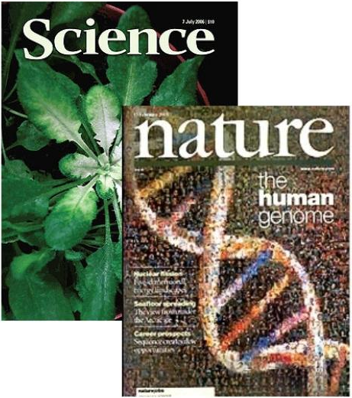
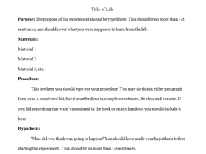
Communicating Information
It is important for scientists to communicate information to each other.
This includes when you prove hypotheses incorrect.
Scientific articles and journals are common vehicles used for scientists to share information.
In our class, we will be sharing our information using lab reports.
Notes:
Cover lab report template at this time.

Slide 27
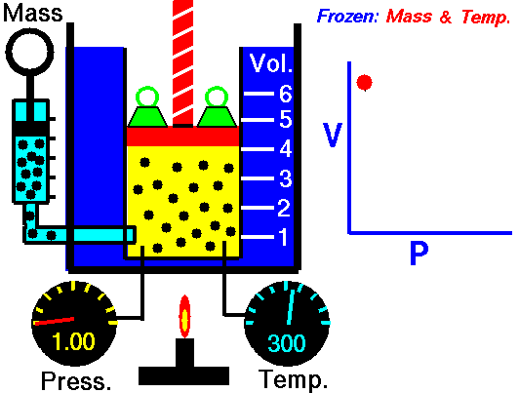
Developing Scientific Laws and Theories
A few successful tests of a hypothesis are not always accepted.
Hypotheses must be tested repeatedly to become accepted.
Definition: Scientific Law – a statement that describes what scientists expect to happen every time under a particular set of conditions.
Examples scientific laws:
Law of gravity
Law of conservation of mass
Notes:
Can anyone think of any examples of a scientific law?

Slide 28
Developing Scientific Laws and Theories
Many concepts do not become scientific laws. Instead, they become scientific theories.
Definition: Scientific Theory – a well-tested idea that explains and connects a wide range of observations.
The largest difference between a scientific law and a scientific theory is that a scientific theory may be proven wrong by new evidence.
In such cases, the theory is either changed or abandoned.

Slide 29
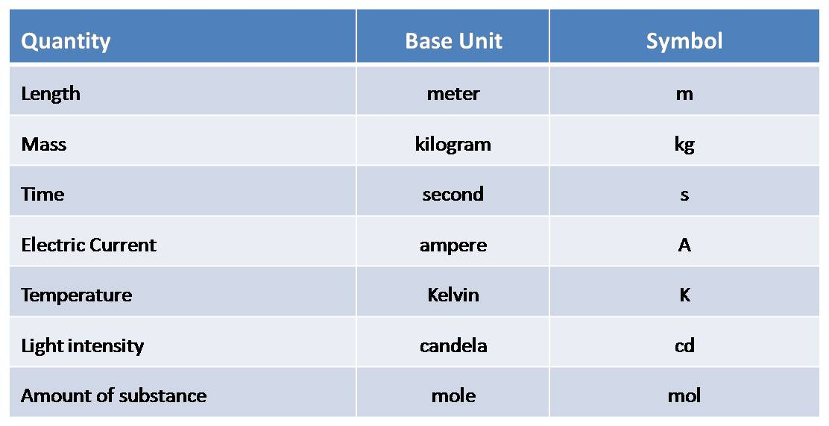
International System of Units (SI)
SI units are based in the metric system.
These units are standardized world wide so that scientists from different countries can communicate easily with one another.
Each type of measurement has it’s own SI unit.
Notes:
Examples: distance is in meters (m), mass is in kilograms (kg), time is in seconds (s), etc.

Slide 30
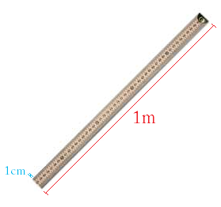
International System of Units (SI)
Prefixes may be used with these measurements.
There are several prefixes used with SI units, for example, centi.
Notes:
End Part 2

Slide 31
SI Unit Prefixes
The prefixes have symbols that are used in conjunction with the symbol for the base unit.
These are the nine prefixes and symbols that you will be required to know.
Please note that the case of the symbols matters. The capital M and the lower case m mean very different things.
NOTE: There are more prefixes than the ones listed here.
Prefix | Symbol
Giga | G
Mega | M
kilo | k
deka | da
(unit) | (unit symbol)
deci | d
centi | c
milli | m
micro | μ
nano | n
Notes:
Additional prefixes: terra, hexa, pico, etc.

Slide 32
SI Unit Prefixes
Each prefix represents a relationship to the base unit, as seen in the table below.
Prefix | Symbol | Meaning | Relation to base unit
Giga | G | 1 000 000 000 | 1Gm = 10⁹m
Mega | M | 1 000 000 | 1Mm = 10⁶m
kilo | k | 1 000 | 1km = 10³m
deka | da | 10 | 1dam = 10m
(unit) | (unit symbol) | 1 | 1m = 1m
deci | d | 0.1 | 1dm = 10⁻¹m
centi | c | 0.01 | 1cm = 10⁻²m
milli | m | 0.001 | 1mm = 10⁻³m
micro | μ | 0.000 001 | 1μm = 10⁻⁶m
nano | n | 0.000 000 001 | 1nm= 10⁻⁹m

Slide 33
SI Unit Prefixes
There are two methods for converting from one prefix of a unit to another: the number line method and the mathematical method.
This number line has all nine prefixes listed on the top, and how many of the base unit each represents on the bottom.
Let’s look at an example of how to convert using the number line method.

Slide 34
Converting Using the Number Line Method
Example – Convert 9.58decigrams to micrograms.
Step 1 – Find the prefix for the unit you are beginning with. In this case, d. On the number line, we can see that d is at 10⁻¹.
Box the prefix that you are beginning with for easy reference.

Slide 35
Converting Using the Number Line Method
Step 2 – Find the prefix that we want to end with. In this case, μ. On the number line, we can see that μ is at 10⁻⁶.
Circle the prefix that you want to end with for easy reference.
Step 3 – Count how many marks it takes to move from d to μ. In this case, it take 5 marks.

Slide 36
Converting Using the Number Line Method
Step 4 – Move the decimal place in your original number this many places.
If you moved to the right on the number line, move the decimal to the right.
If you moved to the left on the number line, move the decimal to the left.
In this case, we move to the right.
9.58dg → 958000μg
Notes:
Click bottom right corner to skip human number line demonstration.

Slide 37
Demonstration
Human Number Line.
Each of you will be assigned one problem on a handout to work out using the number line method for the class.
On the floor at the front of the class is a version of the number line.
When it is your turn to work out a problem on the board, jump along the number line to show how it will be worked out. Then write out the work and answer on the board.

Slide 38
Converting Using the Mathematical Method
In order to use the mathematical method, you must first determine the ratio of the current prefix to the base unit.
Example – Convert 9.58decigrams to micrograms.
In this case, we are starting with the prefix deci.
From the number line above, we can determine that 1dg = 10⁻¹g.

Slide 39
Converting Using the Mathematical Method
From this ratio, we can make two conversion factors, as seen below.
Then pick the conversion factor with the initial prefix in the denominator.
Now multiply the initial value by the selected conversion factor.
1 dg
10⁻¹ g
10⁻¹ g
1 dg
10⁻¹ g
9.58dg*
= 0.958g
1 dg

Slide 40
Converting Using the Mathematical Method
Next, find the ratio between the base unit and the desired prefix.
In this case, the desired prefix is micro. The ratio is 10⁻⁶g = 1μg.
Then we proceed in the same manner as before by making conversion factors.
1 μg
10⁻⁶ g
10⁻⁶ g
1 μg

Slide 41
Converting Using the Mathematical Method
Finally multiply the value in the base unit by the conversion factor with the base unit in the denominator.
Try converting from 2345.75km to Gm using the mathematical method.
Answer: 0.00234575Gm
1 μg
0.958g*
= 958000μg
10⁻⁶ g

Slide 42
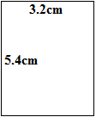
Using Units
Units can be combined into more complicated units.
There will be many times this year that this will be the case.
When we multiply two values with units, the units are multiplied together as well.
For example, when finding the area of the rectangle shown to the left, we end up with a unit of cm².
3.2cm*5.4cm = 17.28cm²

Slide 43
Using Units
When dividing values with units, the units divide into one another as well.
For example, when finding the density of a substance that has a mass of 23.54g and a volume of 18.32mL, the units divide.
m = 23.54g
v = 18.32mL
23.54g
18.32mL
mass
Density =
volume
23.54g
D =
18.32mL
D = 1.285g/mL

Slide 44
Using Units
If, after the multiplication and division are complete, a unit appears both in the numerator and the denominator, they cancel out.
For example, if I am trying to find the velocity change of an object that is accelerating at 9.8m/s² for 4 seconds, one of the seconds in the denominator will cancel, as seen below.
(9.8m/s²)(4s) =
39.2m*s
=39.2m/s
s*s

Slide 45
Using Units
NOTE: Units must have the same prefix and base unit in order to cancel out.
For example, meters will not cancel out with kilometers.
One unit must be converted to the other before they can be combined.
When adding and subtracting values with units, the units must be the same or you cannot add/subtract the values.
Notes:
Prefixes do not cancel out unless their units match.

Slide 46
Practice
Try the practice problems on the worksheet.
Frank, D. V., Little, J. G., Miller, S., Pasachoff, J. M., & Wainwright, C. L. (2001). Physical science. Needham, Mass.: Prentice Hall.

